Slide 1
Knowledge Graph

Slide 2
TEAM
Joel Hawkins
Massi B.Oskouei
Salah Mokhayesh
Praveen Jaikant
Meenraj Dorairaj
Bhavisha Patel

Slide 3
What is a knowledge graph?
A knowledge graph is a programmatic way to connect all data together.
EXAMPLE:
A property with loan number 123, is belong to Massi, located in Rochester, and its loan was closed on 4-6-2020.
Loan Number | FirstName | City | Closed Date
LoanNumber#123 | Massi | Rochester | 04-06-2020
Who is Massi?
Rochester in Michigan or Rochester in New York?
Does 04-06-2020 mean April 6th or June 4th?

Slide 4
Triples
Loan Number | FirstName | City | Closed Date
LoanNumber#123 | Massi | Rochester | 04-06-2020
Rochester
http://ql.com/City
Massi
http://ql.com/PersonName
Subject | Predicate | Object
LoanNumber#123 | FirstName | Massi
LoanNumber#123 | IivesIn | Rochester
LoanNumber#123 | ClosedDate | 04-06-2020
LivesIn
http://ql.com/livesIn
FirstName
http://ql.com/HasfirstName
LN#123
http://ql.com/LnNo
ClosedOn
http://ql.com/livesIn
04-06-2020

Slide 5
RDF Based Data Model
A triple (s,p,o) is such that:
s, p and o stand for subject, property (predicate), and object.
s, p are URI-s, i.e., resources on the web; o is a URI or a literal (a constant value).
URI is used for identifying (naming) resources on the Web
URLs (Uniform Resource Locators) are a particular type of URI, the resources can be accessed on the Web
URIs unlike URLs are not limited to identifying thinks that have network locations
The Resource Description Framework (RDF) is a graph data model that formally describes the semantics, or meaning of information. RDF consists of triples.
RDF is a general model for such triples (with machine readable formats like RDF/XML, Turtle, JasonDB, RXR,…)

Slide 6
Vocabulary Standard (ontology) - RDFs, OWL, FOAF, etc.
An ontology:
is a form of representing knowledge in a data model.
should be understandable by machines.
should allow reasoning.
Some popular ontologies:

Slide 7
RDFs
The main classes defined in RDFS are:
rdfs:Resource: the class of everything
rdfs:Class: the class of all classes
rdfs:Literal: the class of all literal values
rdfs:Datatype: the class of all datatypes
rdf:Property: the class of all properties
rdf :about: referencing an existing resource
RDFS contains several properties
like rdfs:label, rdfs:comment, rdfs:domain, rdfs:range, rdf:type, rdfs:subClassOf and rdfs:subPropertyOf.

Slide 8
Example
ql: <http://qlrdf.com>
ql:Person a rdfs:Class .
ql:TeamMember a rdfs:Class ;
rdfs:subClassOf ql:Person .
ql:hasLoan a rdfs:Property ;
rdfs:domain :Pearson ;
rdfs:range :LoanNo .
If we apply them to the following data:
:alice a :Person . :bob a :TeamMember ; :hasLoan #456. :Massi :hasLoan #123.
An RDFS processor could infer that :bob and :Massi have rdf:type :Person and that #123 has rdf:type :LoanNo.

Slide 9
RDB2RML Mapping
https://www.w3.org/2001/sw/rdb2rdf/r2rml/
https://rml.io/specs/rml/#named-graph
A mapping takes as input a logical table.
A logical table is mapped to a set of triples by a rule called
• triples map
A triples map has two parts:
• a subject map
• several predicate-object maps

Slide 10
TripleMaps
Input of a map:
• a row of the logical table
Output of a map for each row :
• a subject resource, often generated from primary key values
• several triples with the same subject, but varying predicates and objects, generated from the attributes of the row

Slide 11
Example
ClientInfo
We produce triples by:
Subject maps
Predicate maps
Object maps
Example
• The subject IRI is generated from the LoanNumber column by the template http://qlRDF.com/ClientInfo/{LoanNumber}
• The predicate IRI is the constant ql:Fname
• The object is the literal ”Liam”, that is copied from the FirstName column
LoanNumber | FirstName | DateOfBirth
123 | Liam | 1965-10-02

Slide 12
Output
Set of RDF triples
<http://qlRDF.com/ClientInfo/123 > rdf:type ql:ClientInfo.
<http://qlRDF.com/ClientInfo/123 > <http://qlRDF.com/fname> ”Liam".
<http://qlRDF.com/ClientInfo/123 > < http://qlRDF.com /dob> 1965-10-02.
In ttl. Format:
ql : http://qlRDF.com
ql:ClientInfo#123. a ql:ClientInfo;
ql:fname “Liam”;
ql:dob 1965-10-02.

Slide 13
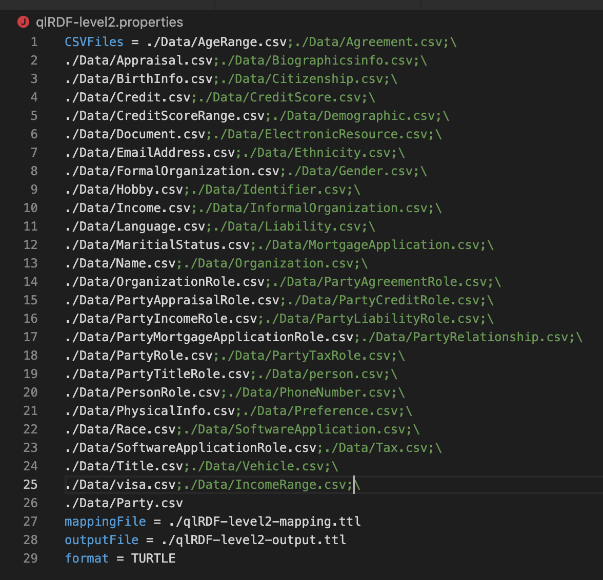
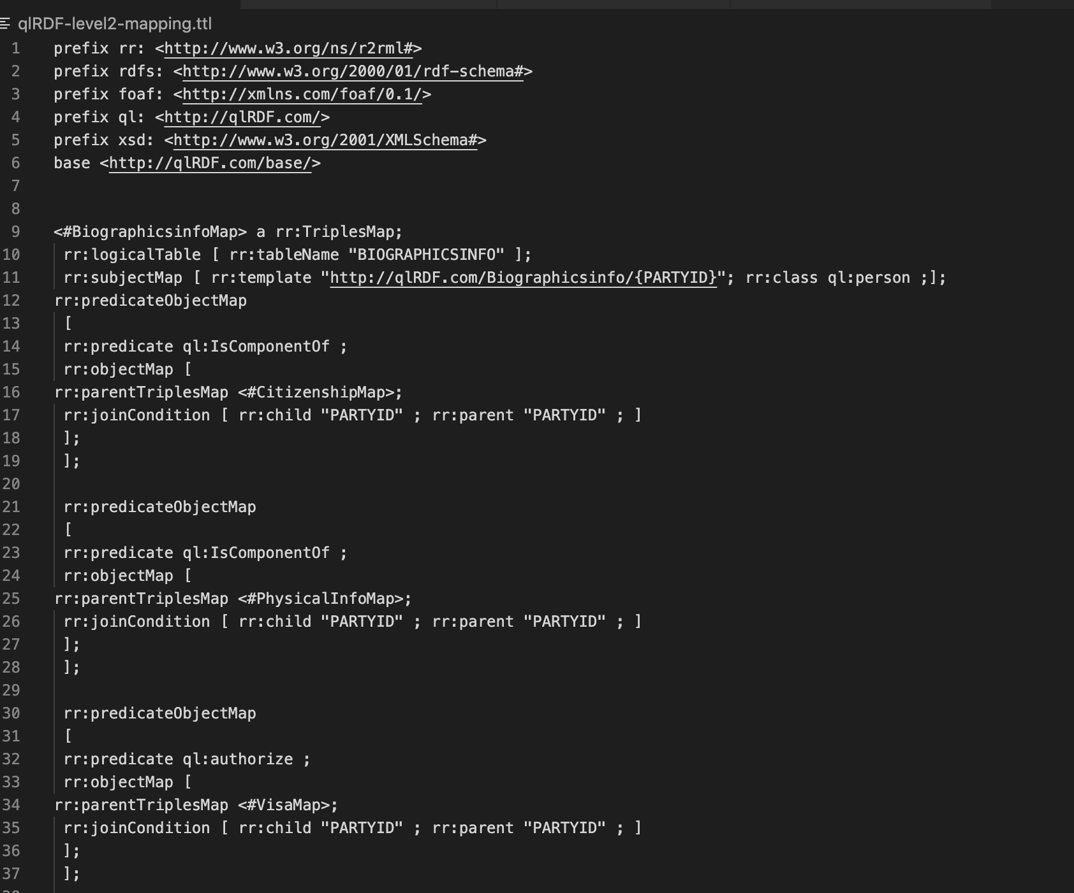
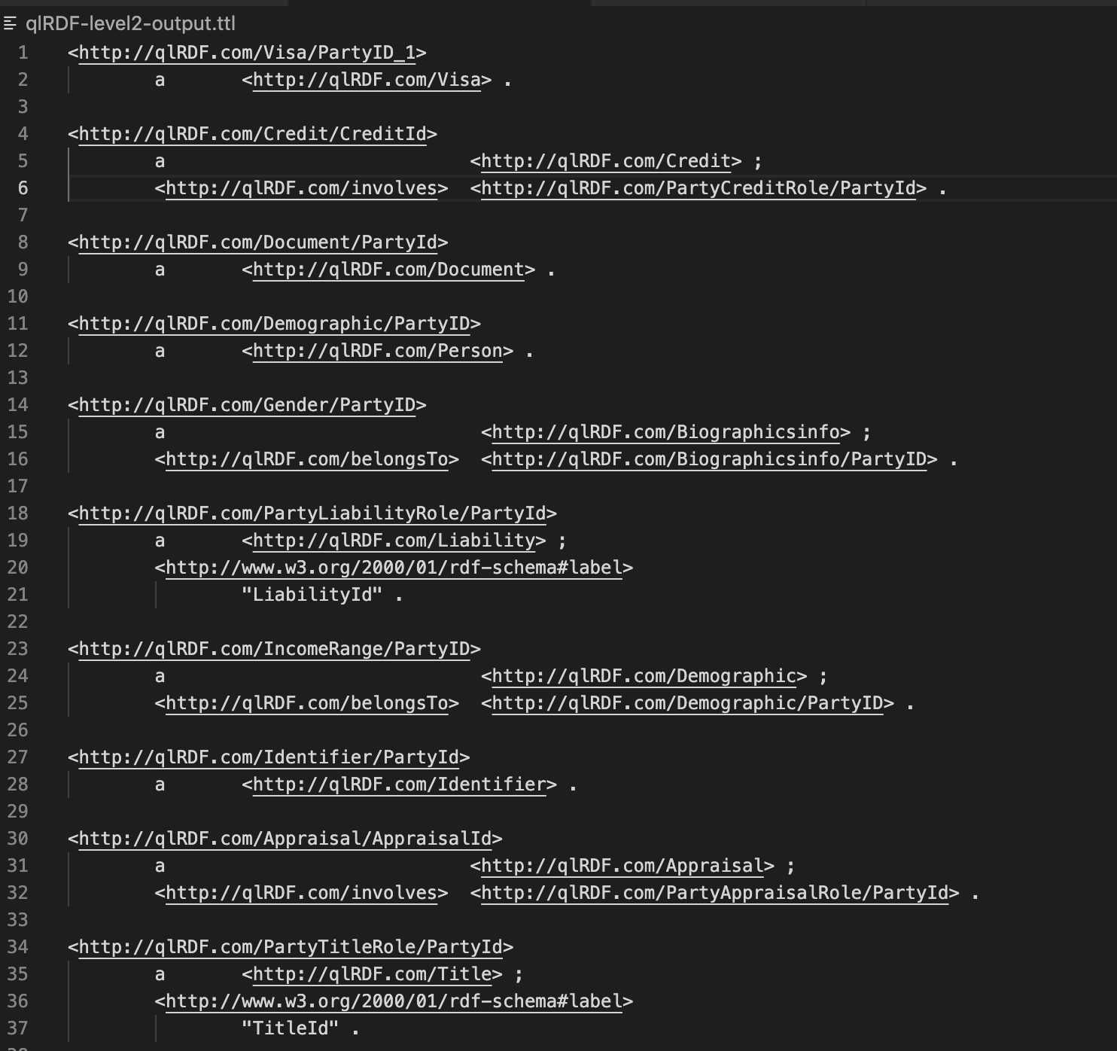
RDF-based models for level 2 metadata

Slide 14
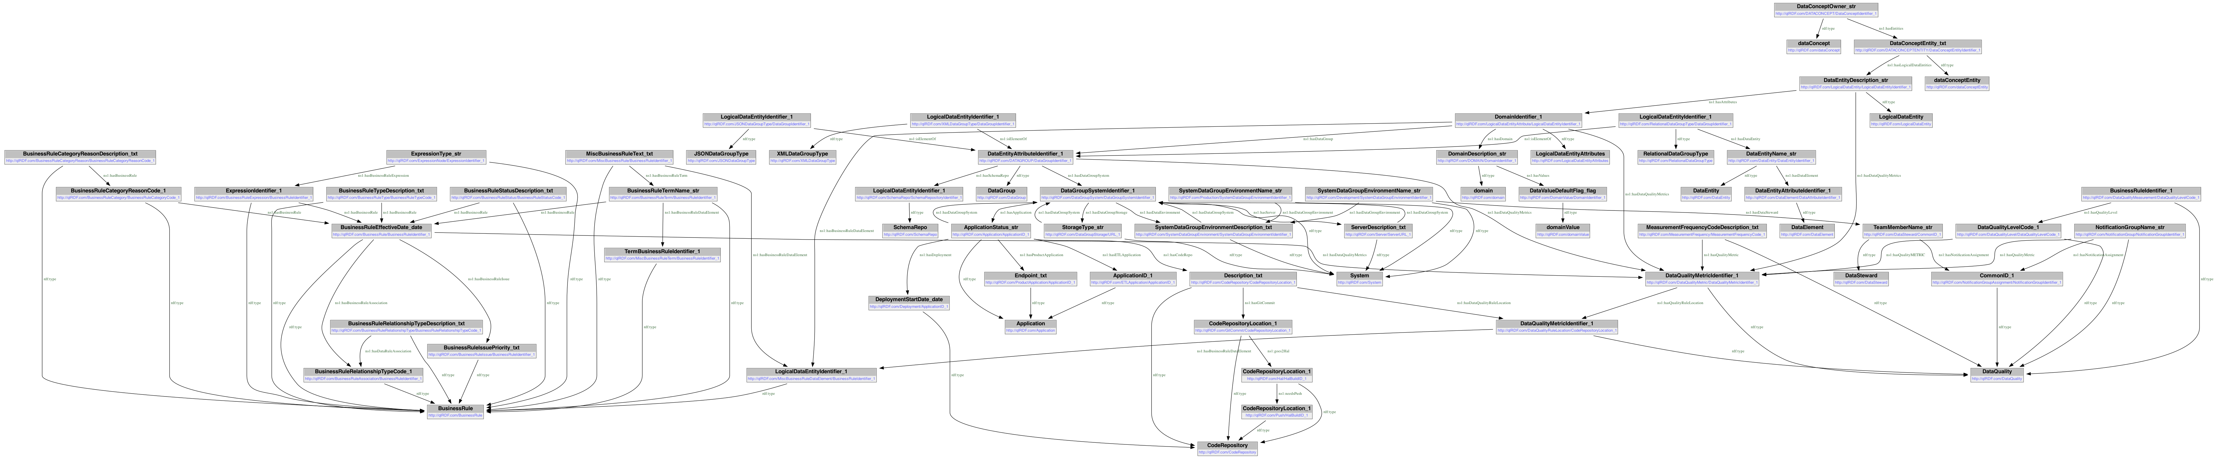
Level 1 & Level 2 Metadata
Level 1 Metadata
Level 2 Metadata

Slide 15
GaM Dataset
Features From Personhub Table | Features From Personhub Table
Rocketaccountid | original_purchase_price
gcid | annual_homeowners_insurance
loannumber | annual_property_tax
current_mortgage_balance | home_phone_number
current_escrow_balance | work_phone_number
current_total_escrow_balance | date_of_birth
Escrowed | personid
biweekly_payment_flag | estimated_home_value
current_monthly_mortgage_payment | is_veteran
isprimaryborrower | hoi_provider
property_address | year_home_built
address_line_2 | original_occupancy_date
city | married
state | employer_name
zip_code | employer_phone_number
property_type | job_title
occupancy | employment_start_date
loan_purpose | yearly_income
is_currentjob | monthsonjob
Features from Amp table | Features from Amp table
rocketaccountid | original_purchase_price
gcid | annual_homeowners_insurance
loannumber | annual_property_tax
current_mortgage_balance | home_phone_number
current_escrow_balance | work_phone_number
current_total_escrow_balance | date_of_birth
escrowed | estimated_home_value
biweekly_payment_flag | veteran
current_monthly_mortgage_payment | hoi_provider
isprimaryborrower | year_home_built
property_address | married
address_line_2 | assets_cash_value
city | assets_balance
state | employer_name
zip_code | employer_phone_number
property_type | job_title
occupancy | job_type
loan_purpose | employer_start_date
yearly_income | monthsonjob
current_job | cashout_viable
lower_payment_viable | shortenterm_viable
original_close_date
Features From Servicing Table | Features From Servicing Table
rocketaccountid | address_line_2
peid | city
reltio_uri | state
gcid | zip_code
loannumber | property_type
current_mortgage_balance | occupancy
currentescrowbalance | loan_purpose
currenttotalescrowbalance | original_purchase_price
isprimaryborrower | annual_homeowners_insurance
escrowed | annual_property_tax
biweekly_payment_flag | home_phone_number
current_monthly_mortgage_payment | work_phone_number
property_address | date_of_birth
original_close_date

Slide 16
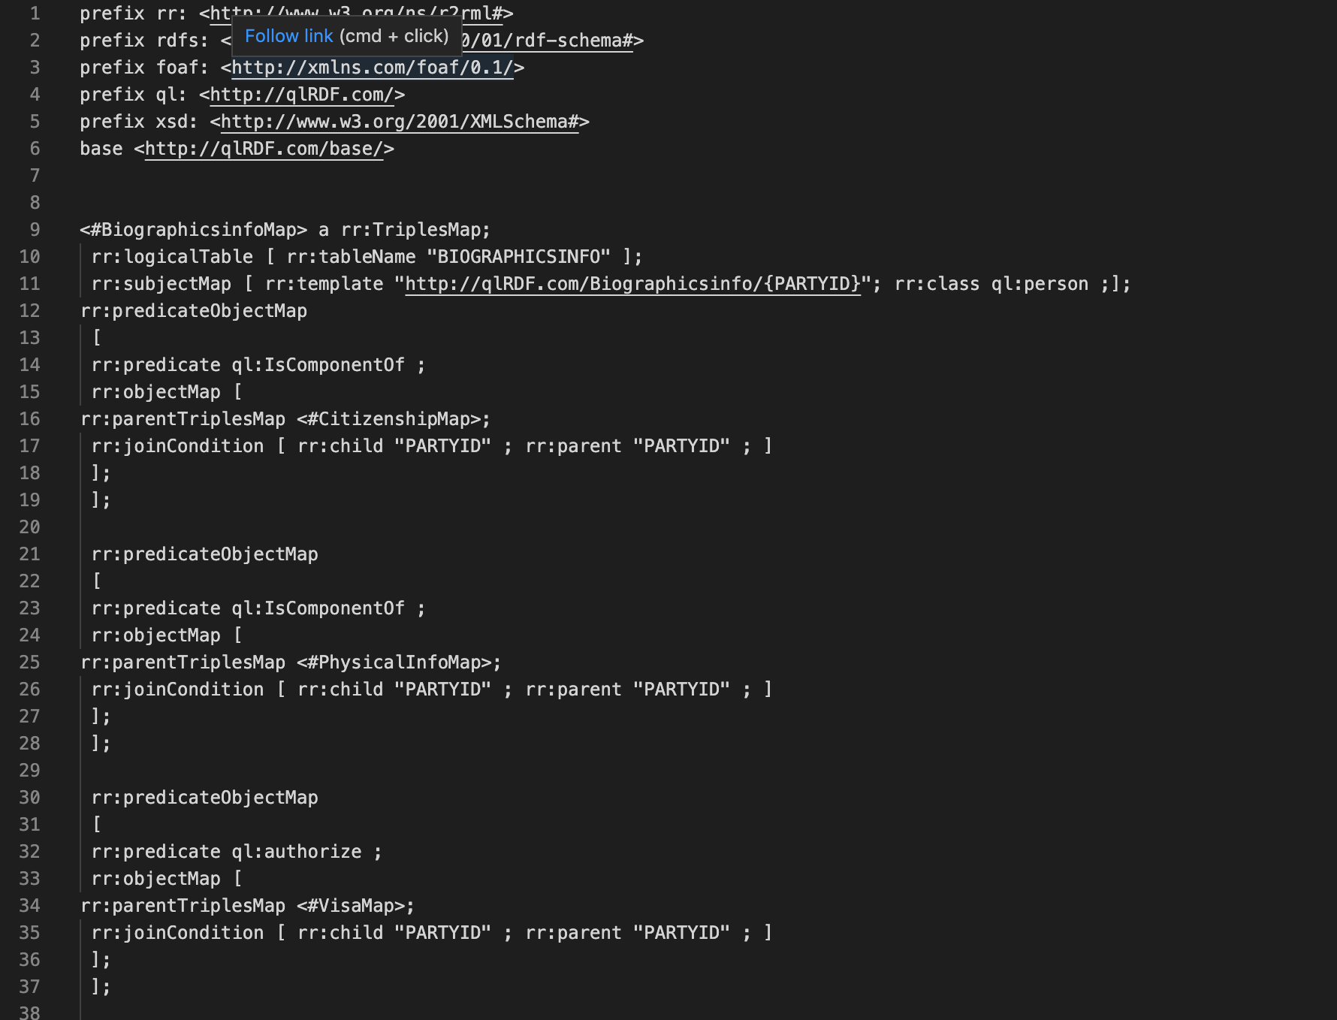
Classified GaM Dataset Attributes
LoanInfo
current_mortgage_balance
currentescrowbalance
currenttotalescrowbalance
escrowed
biweekly_payment_flag
current_monthly_mortgage_payment
loan_purpose
estimated_home_value
hoi_provider
assets_cash_value
assets_balance
original_close_date
Cashout_viable
Lower_payment_viable
Shortenterm_viable
PropertyInfo
property_type
occupancy
original_purchase_price
annual_homeowners_insurance
annual_property_tax
year_home_built
ClientInfo
home_phone_number
work_phone_number
date_of_birth
veteran
married
yearly_income
Employment
employer_name
employer_phone_number
job_title
job_type
employer_start_date
monthsonjob
current_job
Identifier
RocketAccountID
Peid
Reltio_URI
Gcid
Address
property_address
address_line_2
city
state
zip_code

Slide 17
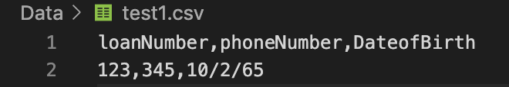
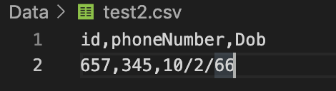
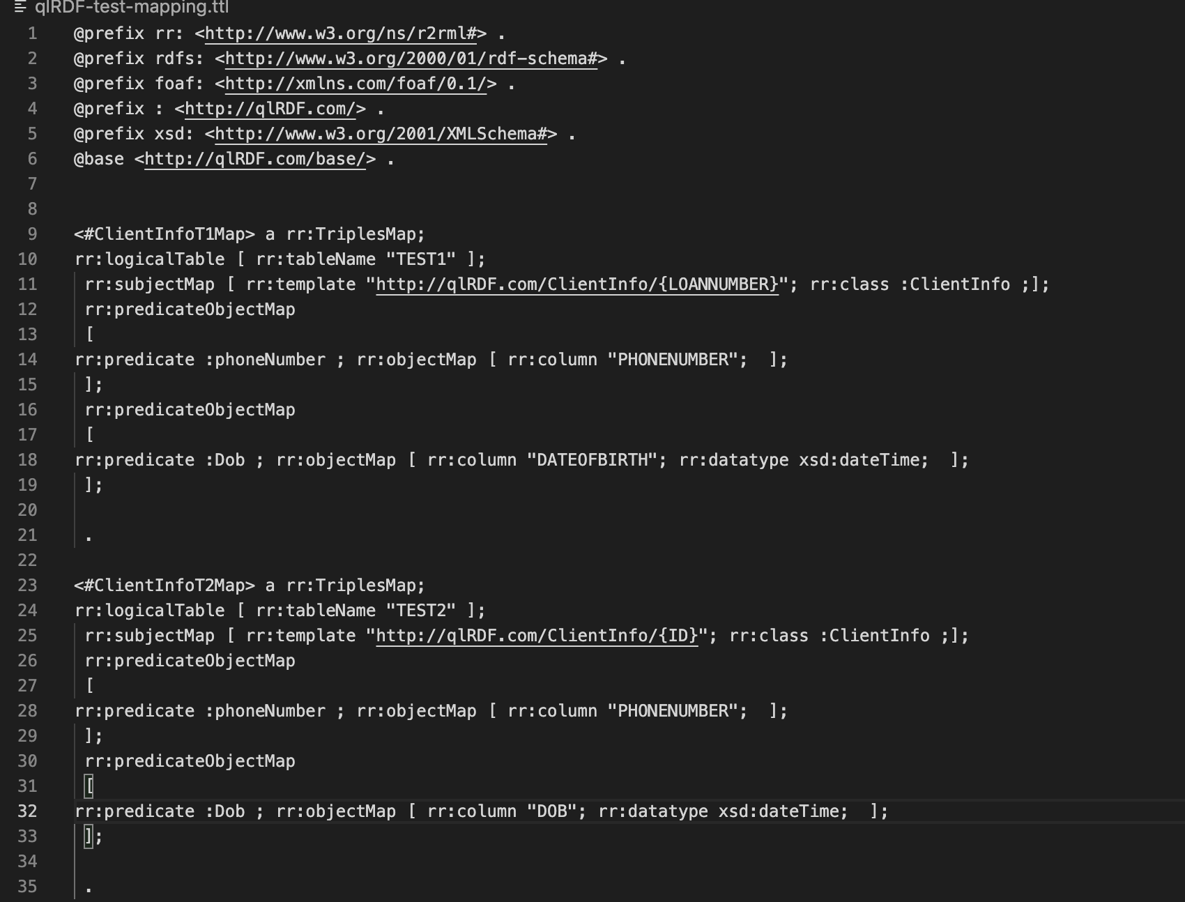
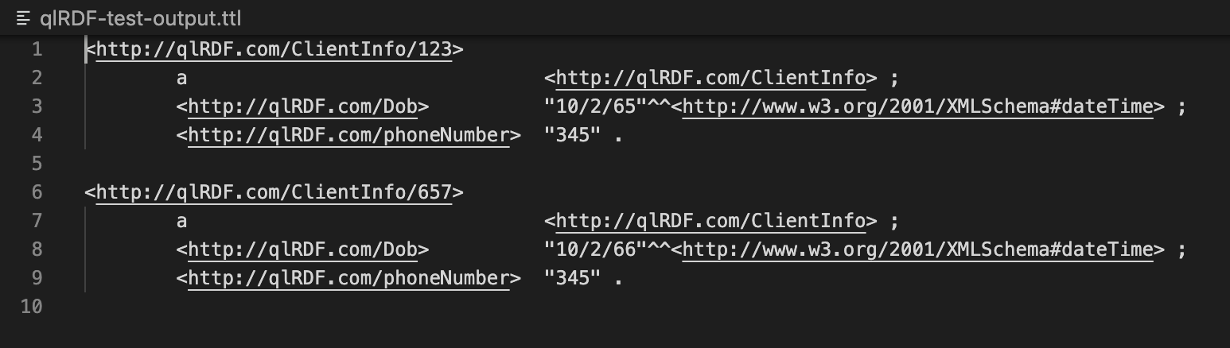
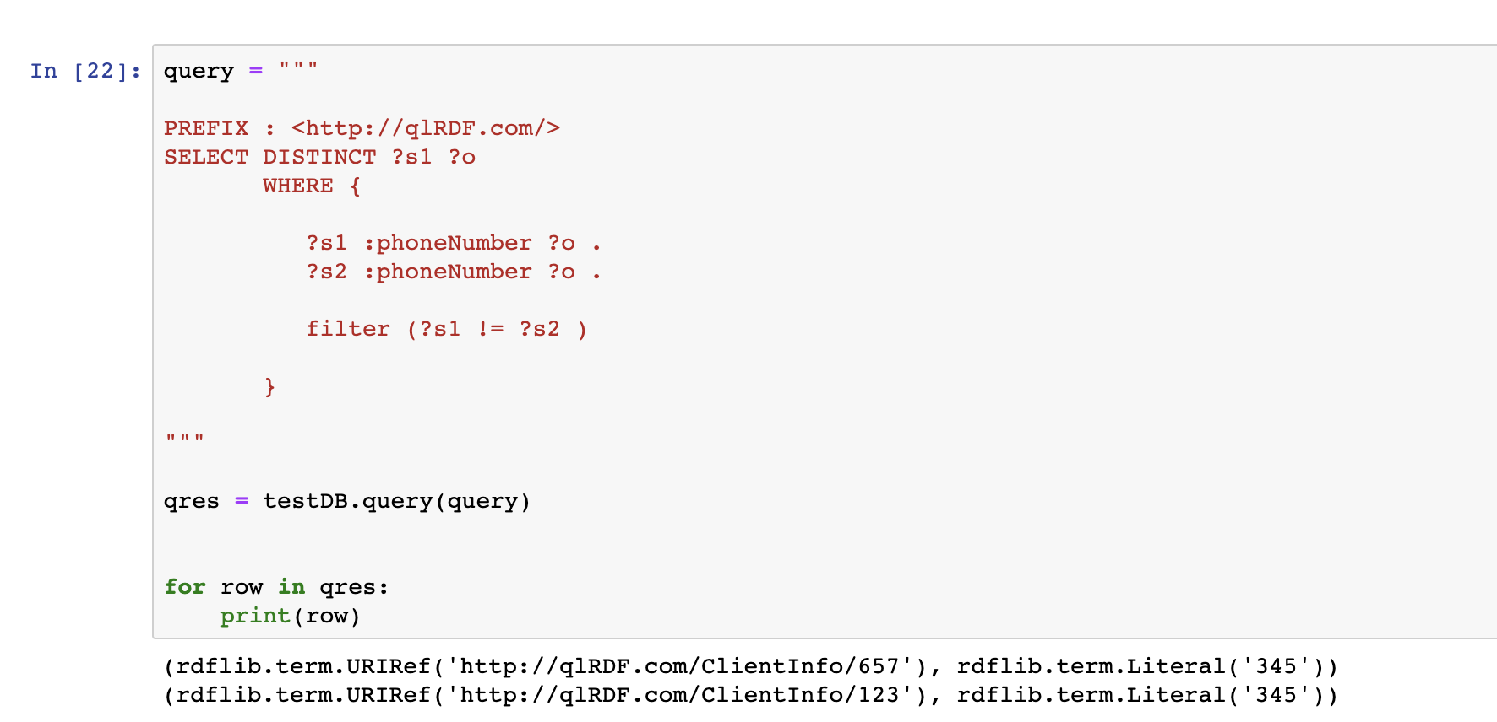
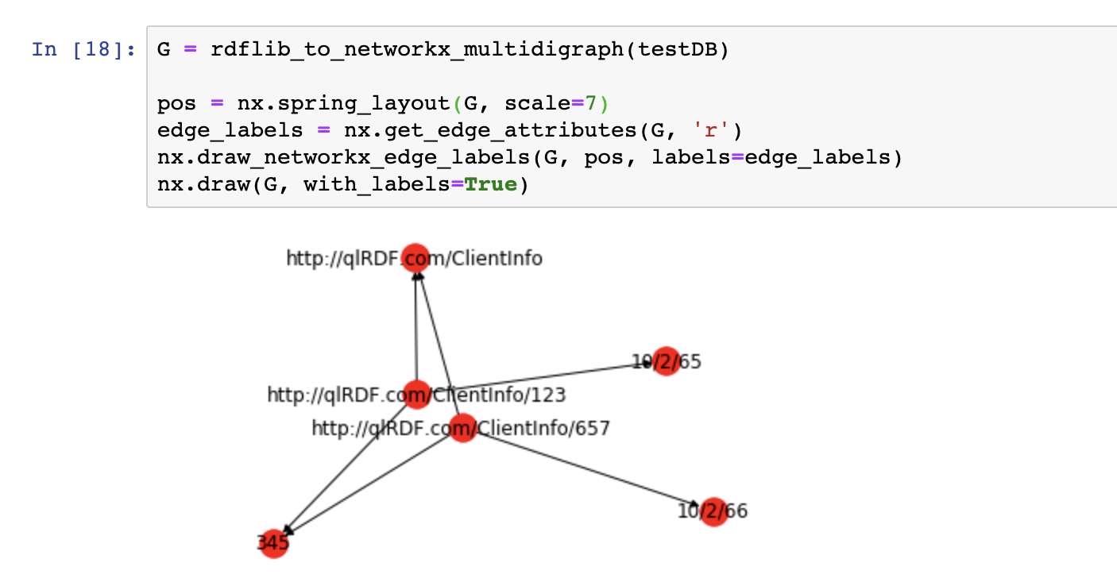
Querying the triples Using SPARQL: on some fake resources

Slide 18

Different use case for Knowledge Graph……. ?!!

Slide 19
